Slide 1
Employee Performance Analysis Using Excel
PRESENTED BY : M. KRISHNAVENI
REGISTER NO : 312204583
DEPARTMENT : COMMERCE
COLLEGE : K.C.S Kasi Nadar College of Arts and science

Slide 2
PROJECT TITLE
Employee Performance Analysis Using Excel

Slide 3
AGENDA
1. Problem Statement
2. Project Overview
3. End Users
4. Our Solution and Proposition
5. Dataset Description
6. Modelling Approach
7. Results and Discussion
8. Conclusion

Slide 4
PROBLEM STATEMENT
"Imbalanced Ratings in Departments" is rewritten as "Imbalanced Departmental Ratings" to make it more concise and clear that the focus is on the ratings within different departments.
"Rating Discrepancies within Pay Zones" is rewritten as "Pay Zone Rating Discrepancies" to streamline the phrasing and make the key focus on the rating discrepancies within the pay zones.
"Departmental Distribution and Size" is rewritten as "Departmental Size and Distribution" to put the key elements in a more natural order.
"Employee Development Needs" remains the same, as the original phrasing is clear and concise.
"Employee Satisfaction and Retention Risk" is rewritten as "Employee Satisfaction and Retention Risks" to make it plural, as there are likely multiple retention risks to consider.

Slide 5
PROJECT OVERVIEW
[Employee Performance Improvement and Pay Zone Optimization]
Employee Attrition Analysis Using Excel Dashboards
Creating an Employee Performance Scorecard in Excel
Using Pivot Tables for Employee Turnover Analysis
Visualizing Employee Attendance Trends with Excel Charts
Salary and Compensation Analysis Through Excel Data Modeling
Data Manipulation Techniques, Conditional Formatting, Pivot Table, Functions and Formulas, Power Query, Charts and Graphs

Slide 6
WHO ARE THE END USERS?
Human Resources (HR) Department
Department Managers (Sales & Production)
Senior Leadership/Executives
Employees
Finance/Compensation Teams

Slide 7
OUR SOLUTION AND ITS VALUE PROPOSITION
Filtering - Remove missing values.
Conditional Formatting - Blanks, Background Color Shading, Data Bars, Values.
Data Filtering and Sorting - Identify specific employee performance groups, such as those with exceeds, needs improvement and fully meets.
Pivot table - Summary of employee performance under their employee Id.
Graphs - Final Report with Trend line.

Slide 8
DATASET DESCRIPTION
EMPLOYEE ID: Unique identifier for each employee in the organization.
FIRST NAME: The first name of the employee.
PAY ZONE: The pay zone or salary band to which the employee's compensation falls.
DEPARTMENT TYPE: The broader category or type of department the employee's work is associated with.
CURRENT EMPLOYEE RATING: The current rating or evaluation of the employee's overall performance.

Slide 9
MODELLING
Data set: Kaggle, Employee dataset
Feature Selection: slicer ,conditional formatting, designing.
Data Cleaning: Missing values, Irrelevant data, correct errors, Remove unnecessary coloums and rows.
Pivot Table: Employee ID, First Name, Payzone, DepartmentType, Current Employee Rating.
Performance:
Report: Slicer
Chart: Report of employees based on their current ratings is resented as coloum chart

Slide 10
RESULTS

Slide 11
CONCLUSION
Based on the bar chart provided, a possible conclusion might be:"The analysis of current employee ratings across various categories indicates a significant variance in performance. While some categories exhibit higher ratings, suggesting strong performance in those areas, others have lower ratings, highlighting potential areas for improvement. Overall, this data underscores the need to focus on targeted strategies to enhance employee performance in the lower-rated categories while maintaining high standards in the stronger areas."Feel free to adjust this conclusion depending on the specific context or goals of your presentation.

Slide 12
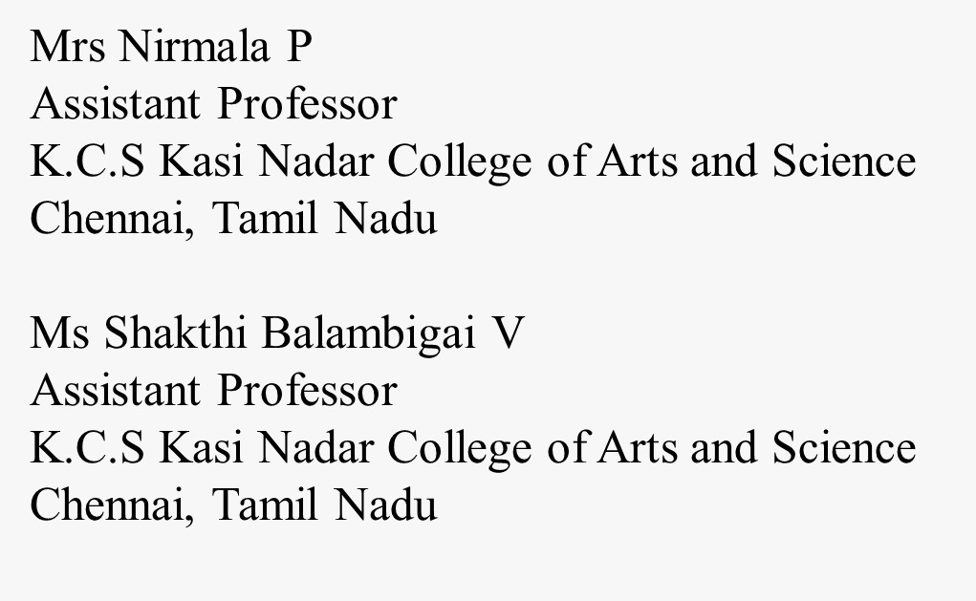
REFERENCE

